Slide 1

IT TICKET ANALYSIS
Priya Kumari
04 July 2026

Slide 2
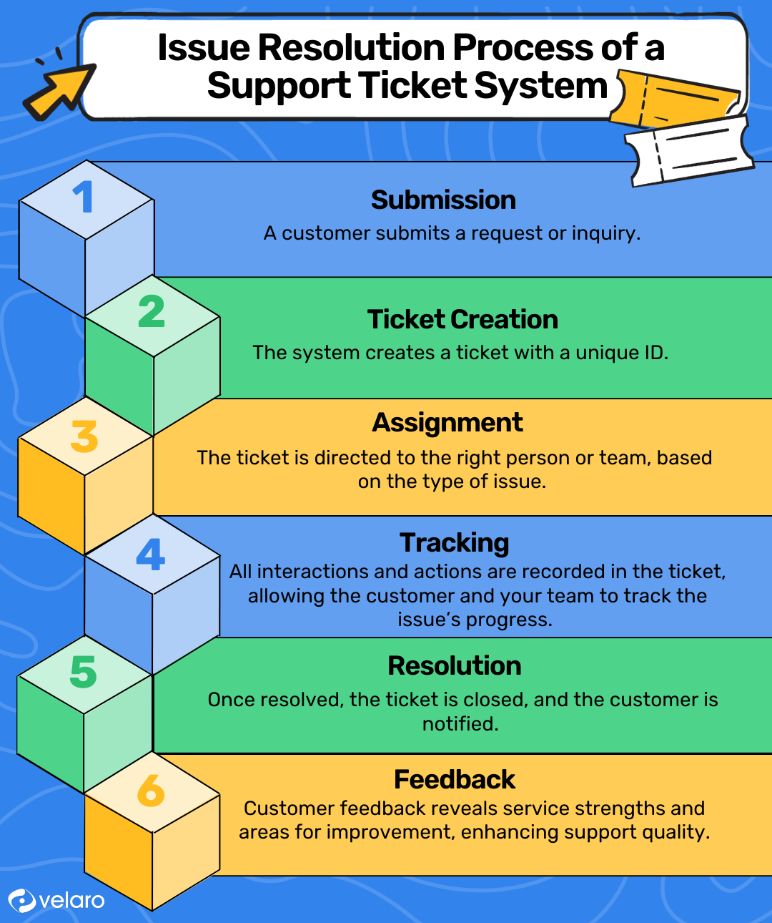






About IT TICKET MANAGEMENT SYSTEM
What is an IT Ticket?
An IT support ticket is a digital record created when an employee reports a technical issue or service request. It captures the complete lifecycle of the issue—from creation and assignment to resolution and feedback—helping organizations track performance, ensure accountability, and deliver timely IT support.
How the IT Ticket Process Works?
Employee Raises an Issue
Ticket is Created
Ticket is Assigned to IT Agent
Issue is Diagnosed & Resolved
Ticket Closed
Employee Provides Feedback

Slide 3
PROBLEM STATEMENT
You are tasked with analyzing the IT support ticket management system to understand the performance of IT agents, the efficiency of ticket resolution, and the satisfaction levels of employees. The objective is to identify high and low performers among IT agents, assess the overall effectiveness of the team, and pinpoint areas for improvement in the ticket resolution process. The ultimate goal is to make informed staffing decisions, including hiring, firing, and training, to enhance overall service quality and team performance.

Slide 4

OBJECTIVE
Evaluate Agent Performance
Identify high-performing and low-performing IT support agents based on ticket handling and resolution metrics.
⏱️ Measure Resolution Efficiency
Analyze ticket resolution times to identify delays and improve service efficiency.
🎫 Understand Ticket Patterns
Examine request categories, issue types, severity, and priority to identify recurring trends.
⭐ Assess Employee Satisfaction
Evaluate user satisfaction ratings to measure the quality of IT support services.
💡 Provide Actionable Recommendations
Recommend data-driven strategies for staffing, training, workload distribution, and process improvement.

Slide 5
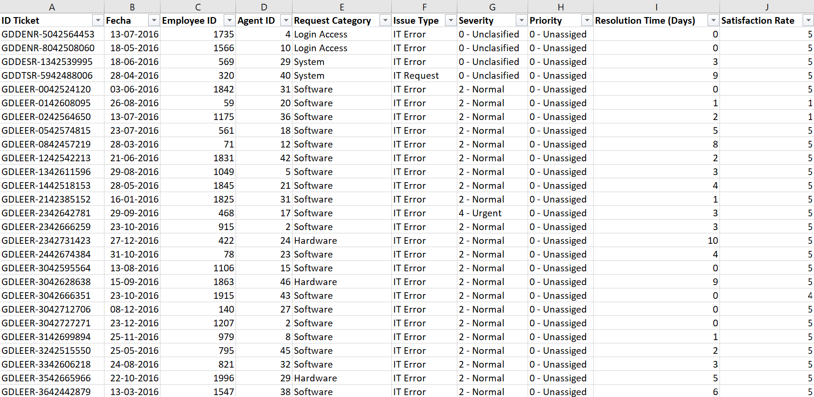
DATA OVERVIEW
This project uses two interconnected datasets to analyze the performance and efficiency of the IT support process.
The datasets capture information about support tickets and the IT agents responsible for resolving them.
Datasets Used:
Tickets - Contains records of employee support requests, including ticket details, issue information, priority, severity, resolution time and satisfaction ratings.
IT Agents - Contains information about IT support agents responsible for handling and resolving support tickets.
Key Attributes: Tickets
ID Ticket
Fecha (Date)
Employee ID
AGENT ID
Request Category
Issue Type
Severity
Priority
Resolution time (Days)
Satisfaction Rate

Slide 6
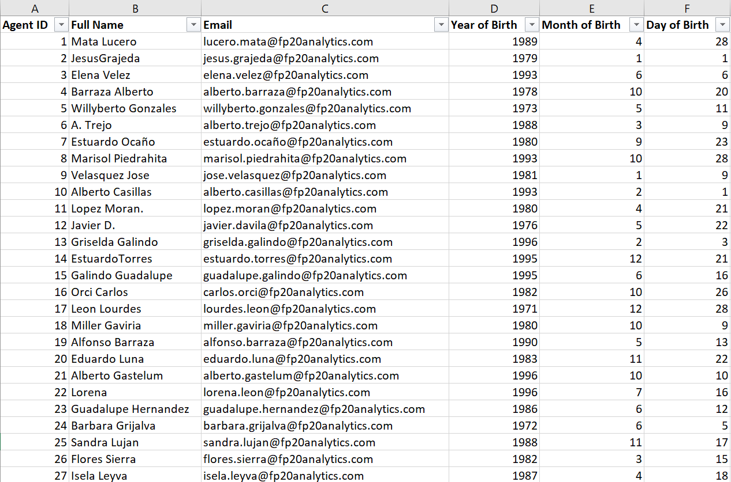
Key Attributes: IT Agents
Agent ID
Full Name
Email
Year of Birth
Month of Birth
Day of Birth
Data Relationship:
Agent ID serves as the common
key linking both datasets

Slide 7
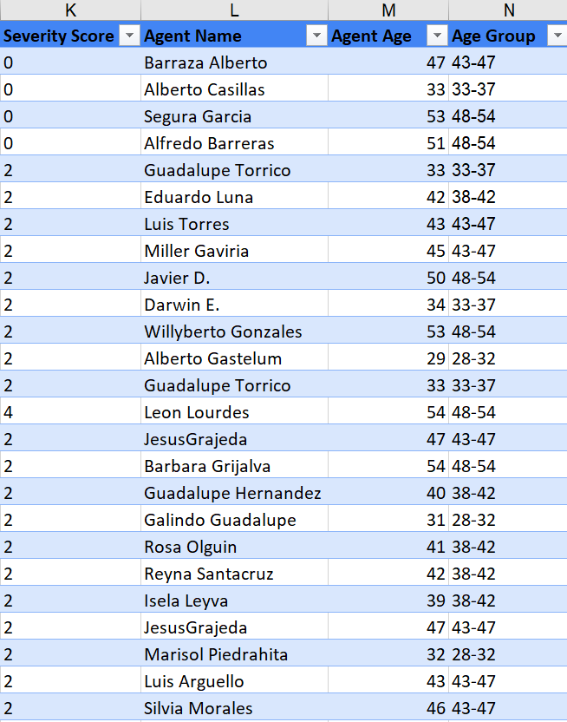
DATA CLEANING & PREPROCESSING
Standardized Severity and Priority values using descriptive labels for consistent analysis.
Validated the dataset by checking for formatting inconsistencies.
Added Agent Name to the ticket dataset using VLOOKUP for agent-wise performance analysis.
Merged separate Year, Month, and Date fields into a single Date of Birth (DOB) column, which was used to calculate Agent Age and create Age Groups.
Created helper columns such as Severity Score and other helper columns for reporting.
Converted the dataset into Excel Tables to enable dynamic Pivot Tables, charts, and dashboards.

Slide 8
METHODOLOGY
Data Cleaning
Standardized Severity and Priority values and validated the dataset by formatting inconsistencies using FIND & REPLACE
Data Enrichment
Used VLOOKUP, DATE, DATEDIF, and IFS to create DOB, Agent Name, Agent Age, and Age Groups for enhanced analysis.
Data Analysis
Calculated KPIs using COUNT, COUNTA, COUNTIF, AVERAGE and other aggregation functions.
Trend Analysis
Performed time-series trend analysis using Pivot Tables and Line Charts to identify ticket volume, resolution time, and satisfaction trends.
Visualization
Designed four interactive dashboards with KPIs, Pivot Charts, and Slicers for Year, Priority, Severity, and Request Category.
Business Analysis
Conducted performance, demographic and trend analysis to generate data-driven business recommendations.

Slide 9
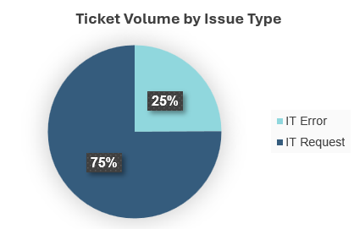
Ticket Volume by Issue Type
Analysis:
IT Requests accounted for 75% of all tickets, forming the majority of the support workload.
IT Errors represented only 25% of total tickets.
Most support activities were service requests rather than system failures.
The ticket distribution indicates a higher demand for routine IT support services.
Insight:
The dominance of IT Requests suggests that improving self-service options, standardizing common request processes, and automating repetitive tasks can significantly reduce support workload and improve operational efficiency.

Slide 10
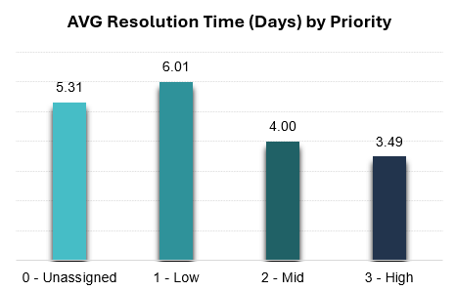
Resolution Time by Priority
Analysis:
Low Priority tickets had the highest average resolution time at 6.01 days.
High Priority tickets were resolved the fastest, averaging 3.49 days.
Resolution time decreased as ticket priority increased, indicating effective prioritization.
The difference in resolution time reflects the impact of timely escalation for critical issues.
Insight:
The support team effectively prioritizes critical tickets, ensuring faster resolution for high-priority requests. However, the longer resolution time for low-priority tickets suggests an opportunity to optimize resource allocation without affecting service quality.

Slide 11
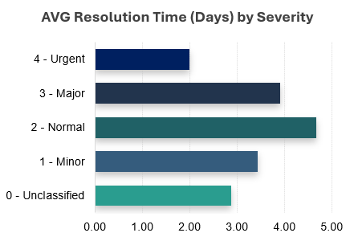
Resolution Time by Severity
Analysis:
Normal severity tickets had the highest average resolution time at 4.66 days.
Major (3.91 days) and Minor (3.44 days) issues followed in average resolution time.
Urgent tickets were resolved the fastest, averaging 2.00 days.
Resolution time does not increase with severity, indicating effective prioritization of critical issues.
Insight:
The team responds quickly to urgent issues, while Normal severity tickets take longer due to their higher volume. This suggests that prioritization is working effectively, but improving the handling of routine tickets can further reduce overall resolution time.

Slide 12
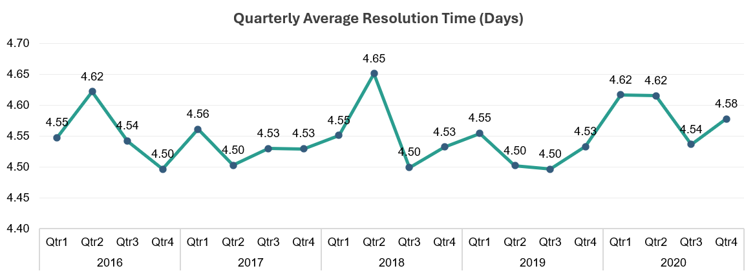
Quarterly Resolution Time Trend (Days)
Analysis:
The average quarterly resolution time remained stable between 4.50 and 4.65 days throughout the five-year period.
The highest average resolution time (4.65 days) was recorded in Q2 2018.
The lowest average resolution time (4.50 days) occurred in multiple quarters, indicating consistent service performance.
Despite increasing ticket volumes over the years, the average resolution time remained relatively stable, reflecting efficient handling of the growing workload.
Insight:
The consistent resolution time across all quarters demonstrates that the IT support team maintained stable service performance despite the continuous increase in ticket volume, indicating effective workload management and operational efficiency.

Slide 13
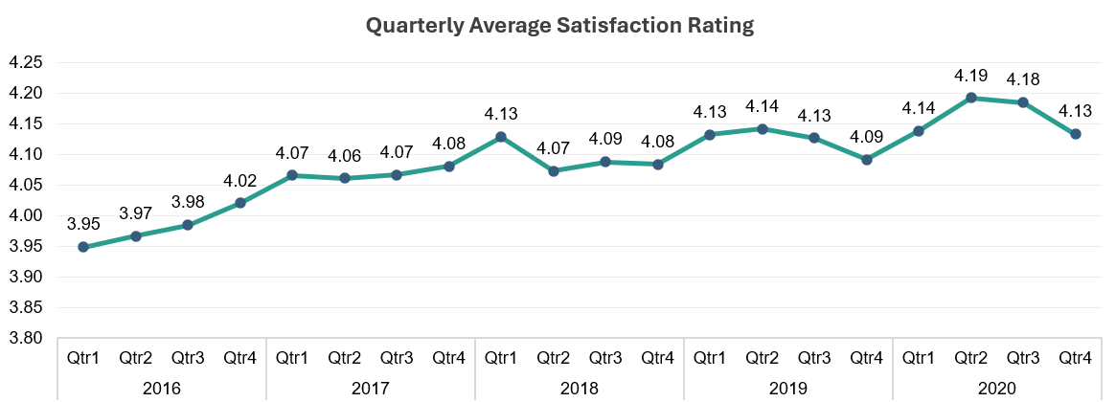
Quarterly Satisfaction Trend
Analysis:
Average customer satisfaction improved steadily from 3.95 in Q1 2016 to 4.19 in Q2 2020.
Satisfaction ratings remained consistently above 4.0 from 2017 onwards, indicating stable service quality.
The highest average satisfaction rating (4.19) was recorded in Q2 2020.
Despite the continuous increase in ticket volume, customer satisfaction remained high, demonstrating effective support performance.
Insight:
The steady improvement in customer satisfaction over the five-year period indicates that the IT support team successfully maintained service quality while managing an increasing number of support requests.

Slide 14
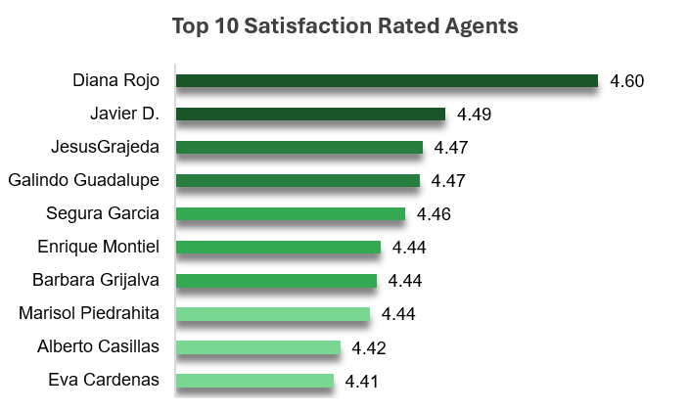
Highest Satisfaction Rated Agents
Analysis:
Diana Rojo achieved the highest satisfaction rating of 4.60, followed by Javier D. (4.49).
All Top 10 agents maintained ratings between 4.41 and 4.60, reflecting consistently high service quality.
The small variation in ratings indicates a uniform customer experience among the best-performing agents.
These agents can serve as benchmarks for customer service excellence and best practices.
Insight:
The consistently high satisfaction scores of the top-performing agents highlight effective communication and problem-solving skills. Identifying and sharing their best practices can help improve customer satisfaction across the entire support team.

Slide 15
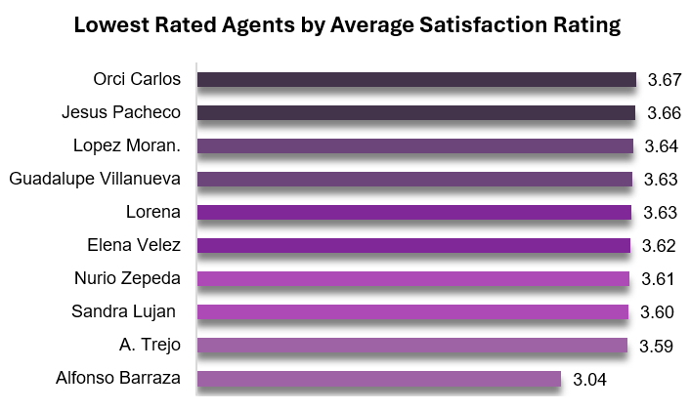
Lowest Satisfaction Rated Agents
Analysis:
Alfonso Barraza recorded the lowest average satisfaction rating of 3.04, significantly below the rest of the group.
The remaining agents had ratings between 3.59 and 3.67, showing relatively consistent but lower customer satisfaction.
The gap between the highest and lowest ratings indicates differences in customer experience across agents.
These agents represent opportunities for targeted coaching and performance improvement.
Insight:
Reviewing the support approach of lower-rated agents and providing targeted training can help improve customer satisfaction and create a more consistent service experience across the team.

Slide 16
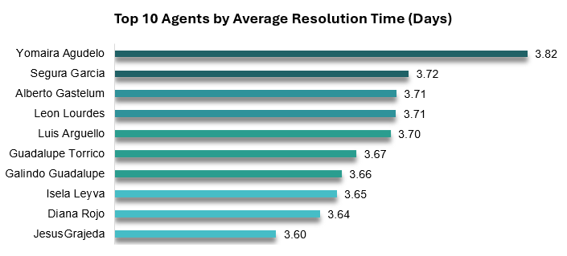
Fastest Agents by Average Resolution Time
Analysis:
Jesus Grajeda achieved the fastest average resolution time at 3.60 days.
The Top 10 agents resolved tickets within a narrow range of 3.60–3.82 days, showing consistent efficiency.
Faster resolution times indicate effective ticket handling and strong operational performance.
These agents can serve as benchmarks for improving team-wide productivity.
Insight:
The performance of the fastest agents highlights efficient ticket management practices. Sharing their workflows and best practices across the team can help reduce overall resolution time and improve service efficiency.

Slide 17
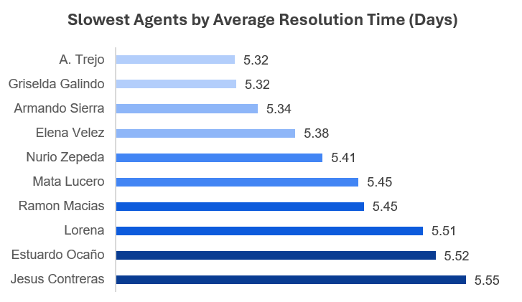
Slowest Agents by Average Resolution Time
Analysis:
Jesus Contreras recorded the slowest average resolution time at 5.55 days, followed by Estuardo Ocaño (5.52 days).
The Top 10 slowest agents required 5.32–5.55 days to resolve tickets.
The small variation in resolution time suggests a common opportunity to improve efficiency across this group.
Targeted training and process optimization can help reduce ticket resolution time.
Insight:
Analyzing the workflows of slower-performing agents can help identify operational bottlenecks. Addressing these through coaching, better resource allocation, and standardized practices can improve overall service efficiency.

Slide 18
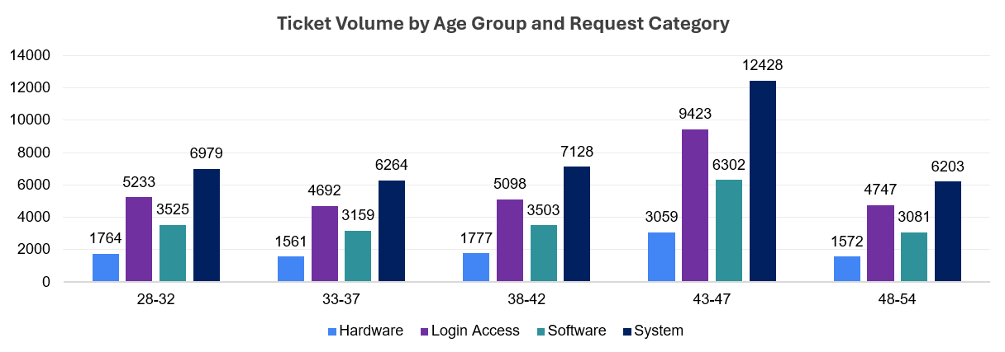
Demographic Analysis
Analysis:
The 43–47 age group handled the highest ticket volume across all request categories.
System requests dominated every age group, with the highest count (12,428) in the 43–47 age group.
Login Access and Software requests followed a similar pattern, peaking in the 43–47 age group.
Ticket volume declined in the 48–54 age group, indicating a relatively lower workload.
Insight:
Agents aged 43–47 managed the highest workload across all request categories, suggesting this age group played a key role in support operations. The findings indicate that workload distribution varies across age groups and can support workforce planning and resource allocation.

Slide 19
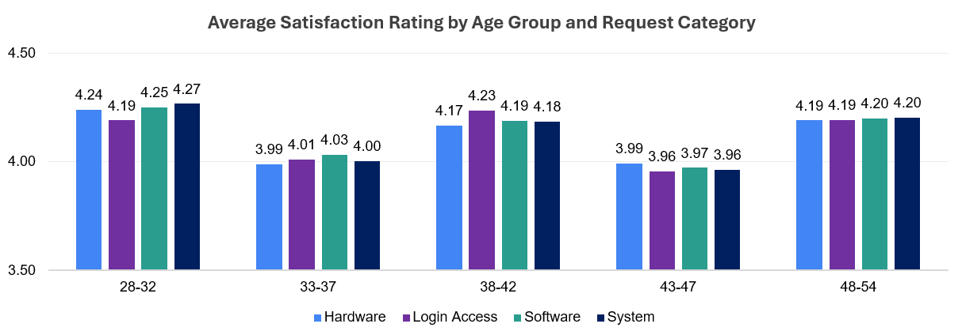
Customer Satisfaction by Age Group
Analysis:
The 28–32 age group recorded the highest satisfaction ratings, reaching 4.27 for System requests.
The 43–47 age group showed the lowest average satisfaction scores, ranging from 3.96–3.99.
Satisfaction remained consistently high across all age groups, varying within a narrow range of 3.96–4.27.
Differences across request categories were minimal, indicating a consistent customer experience.
Insight:
Customer satisfaction remained stable across all age groups. The slightly lower ratings for the 43–47 age group suggest an opportunity to balance workload and maintain consistently high service quality.

Slide 20
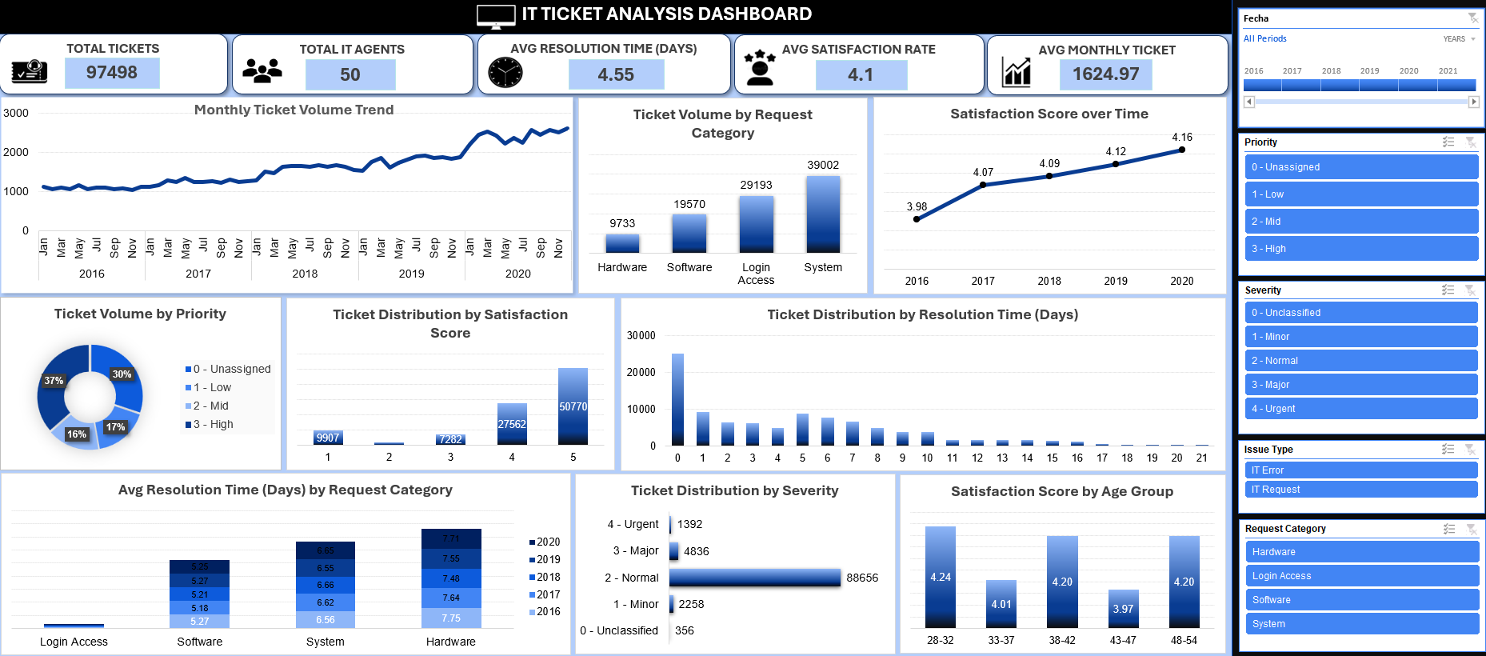
IT TICKET DASHBOARD

Slide 21
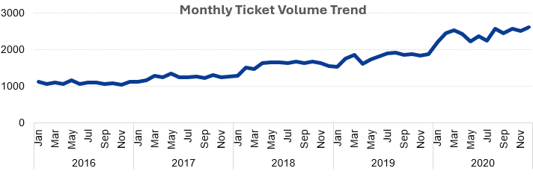
Ticket Volume Trend
Insight:
The continuous increase indicates a growing workload and greater dependence on IT support services.
The sharp rise in 2020 may require additional staffing, better workload distribution, or process automation to maintain service efficiency.
Future resource planning should account for continued ticket growth to prevent agent overload and delays in ticket resolution.

Slide 22
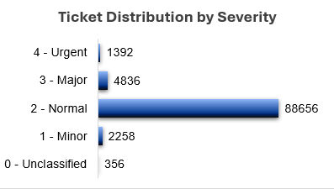
Ticket Distribution by Severity
Insight:
The high volume of Normal tickets indicates that most support activities involve routine operational issues rather than critical incidents.
Standardized workflows, self-service solutions, and automation for recurring Normal issues could significantly reduce the overall workload.
Although Major and Urgent tickets are fewer, they should continue to receive priority handling and timely escalation to minimize operational impact.

Slide 23
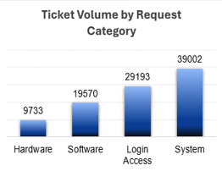
Ticket Volume by Request Category
Insight:
The high volume of System requests indicates that system-related support is the primary driver of the IT team’s workload.
Frequently occurring System and Login Access requests should be reviewed for opportunities to introduce automation, self-service solutions, and standardized troubleshooting procedures.
Although Hardware has the lowest ticket volume, its support requirements should be evaluated along with resolution time before making resource-allocation decisions.

Slide 24
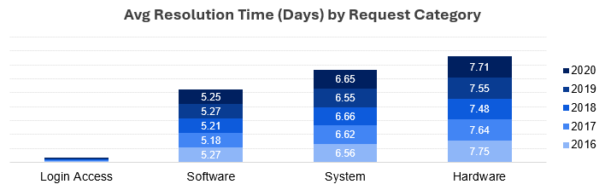
Resolution Time by Request Category
Insight:
Hardware requests may require more complex troubleshooting, physical intervention, or additional resources, resulting in longer resolution times.
Resolution times remained relatively stable from 2016 to 2020, indicating consistent performance but limited improvement in processing efficiency.
Hardware and System support workflows should be prioritized for process optimization, better resource allocation, and specialized technical support.

Slide 25
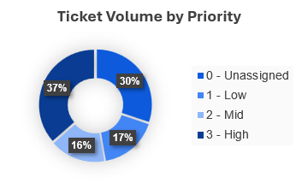
Ticket Volume by Priority
Insight:
The high proportion of High-priority tickets indicates substantial demand for faster response and escalation.
The 30% Unassigned share may affect workload planning and could lead to inconsistent ticket handling.
Clear priority-assignment rules or automated classification can reduce unassigned tickets and improve ticket routing and response efficiency.

Slide 26
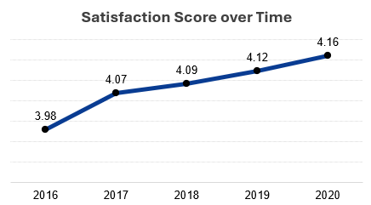
Satisfaction Score over Time
Insight:
The consistent upward trend indicates a gradual improvement in IT support service quality and employee experience.
Rising satisfaction despite increasing ticket volume suggests that the IT support team maintained effective service performance under growing demand.
Continued performance monitoring, agent training, and adoption of best practices can help sustain and further improve satisfaction levels.

Slide 27
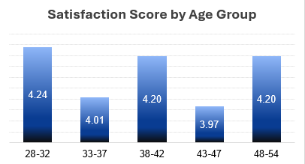
Satisfaction Score by Age Group
Insight:
Satisfaction levels vary moderately across age groups, suggesting differences in service expectations or support experiences.
Lower-rated age groups, particularly 43–47, should be further analyzed to identify recurring concerns or service gaps.
Age-group feedback can help improve support processes, but staffing or performance decisions should not be based on age alone.

Slide 28
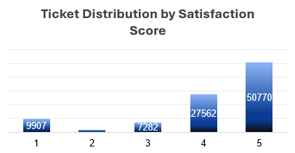
Ticket Volume by Satisfaction Score
Insight:
The high proportion of 4- and 5-star ratings indicates strong overall employee satisfaction and effective IT support performance.
The large number of 5-star ratings suggests that most employees had a positive support experience.
Low-rated tickets, particularly the 9,907 one-star cases, should be analyzed by agent, request category, and resolution time to identify service gaps and targeted training opportunities.

Slide 29
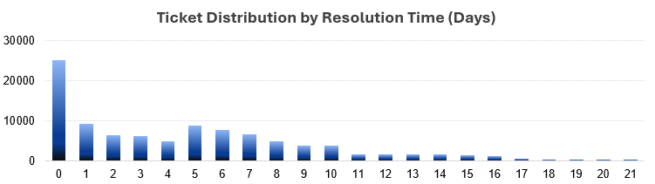
Ticket Volume by Average Resolution Time (Days)
Insight:
The high number of same-day resolutions indicates efficient handling of routine and quickly resolvable requests.
Although most tickets were resolved within a week, tickets requiring more than 10 days should be reviewed to identify delays related to complex issues, resource availability, or escalation.
Management should analyze long-resolution cases by request category and agent to reduce bottlenecks and improve overall service efficiency.

Slide 30
RECOMMENDATIONS
Recognize and reward top-performing agents to encourage high performance and retain skilled employees.
Provide targeted training and mentoring for agents with lower satisfaction ratings or longer resolution times to improve overall team performance.
Automate repetitive Login Access and routine System requests to reduce manual effort and improve response efficiency.
Optimize Hardware support workflows by improving troubleshooting procedures and resource allocation to reduce resolution time.
Balance ticket assignments based on agent expertise and workload to improve service consistency and prevent bottlenecks.
Use performance metrics such as resolution time and customer satisfaction to support staffing, promotion, hiring, and training decisions.
Monitor KPIs through interactive dashboards to identify trends early and support data-driven operational decisions.
Conduct periodic workforce planning to ensure adequate staffing in high-demand support categories and maintain service quality.

Slide 31
CONCLUSION
This analysis provided a comprehensive evaluation of the IT support ticket management system by examining ticket trends, agent performance, resolution efficiency, and customer satisfaction. The insights identified operational strengths, highlighted improvement opportunities, and supported practical recommendations for staffing, training, process optimization, and performance monitoring. The interactive dashboards further enable continuous tracking of key metrics, helping management make informed decisions that improve service quality and overall team performance.

Slide 32
Thank you

